Slide 1
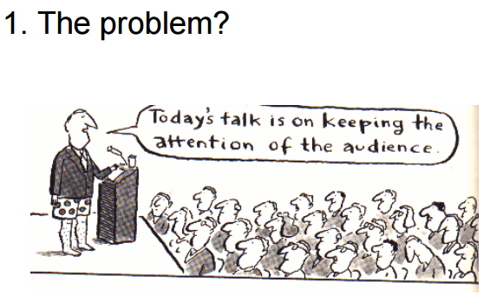

Slide 2
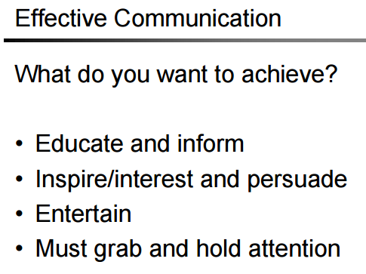

Slide 5
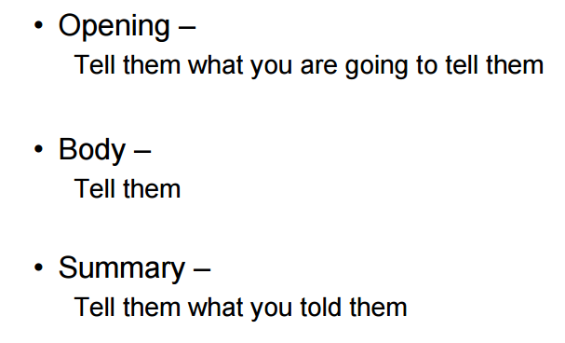
The Three S’s
1. State the point
2. Support the point
3. Summarize the point

Slide 6
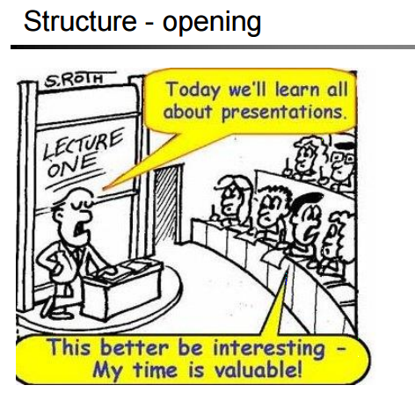

Slide 7
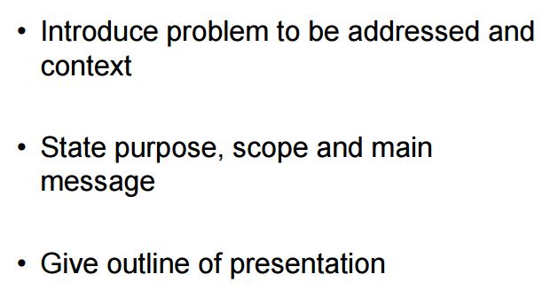
State the point

Slide 8
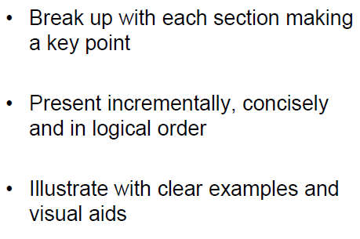

Slide 10
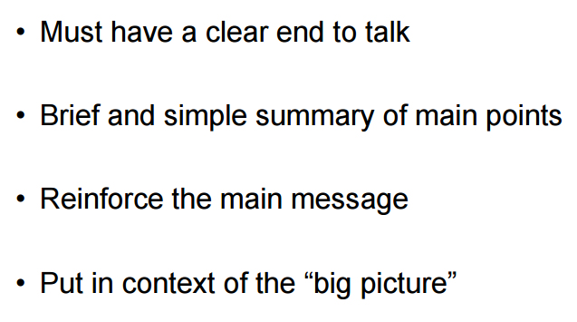

Slide 11
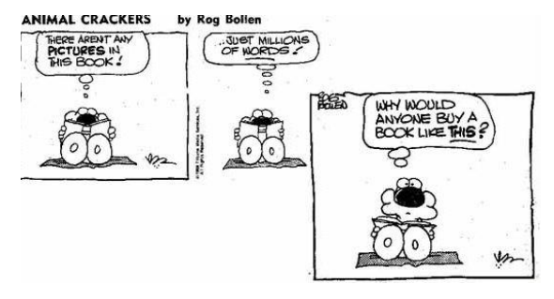

Slide 15
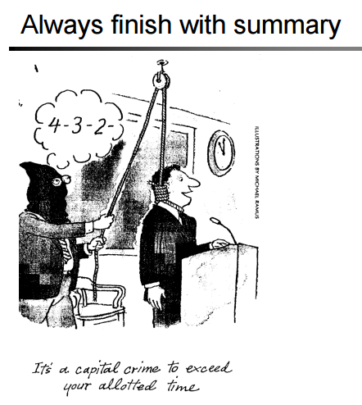

Slide 16
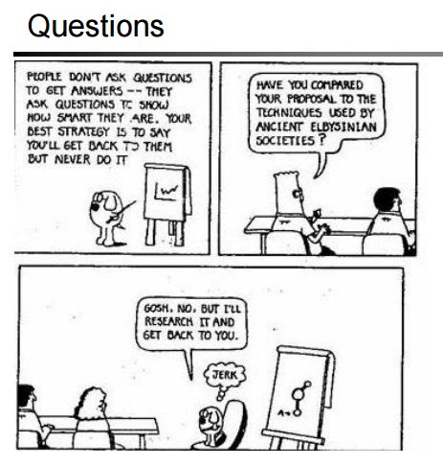

Slide 18
Common Presentation Pitfalls & Corrections
Pitfall Correction
Look mostly at the teacher 3-directional pan
Standing on one spot Different positions
Overburdening slides with words Bullet point
Too many topics to cover Pair up or justify

Slide 19
