Slide 1
Directions: graphical data analysis
Create an MS Word file titled “Graph analyses & conclusions_First name_Last name.doc” and save it to your class folder.
Type the Graph # at the beginning of each set of answers for the graphs that you’ll find below.
In the Word doc, state the Graph # and each separate answer below that:
Title: retype or add a title for each graph if it is missing.
Determine what the IV and DV’s were in the study. Were there any?
State what you feel the purpose of the graph was. Remember to use the correct question format here (“How does the IV affect the DV?”)
What were the MAJOR findings. There will be a lot of results in some of the graphs, so the key question is, “what are the most interesting or important results?” There should be many!!
Did you expect to see these results? Any surprise? Why?

Slide 2
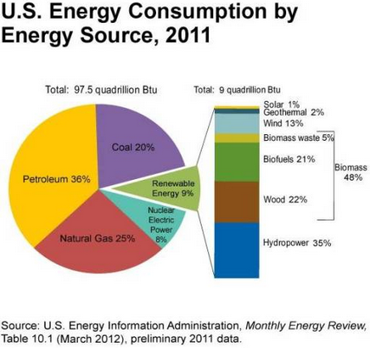
Graph 1.

Slide 3
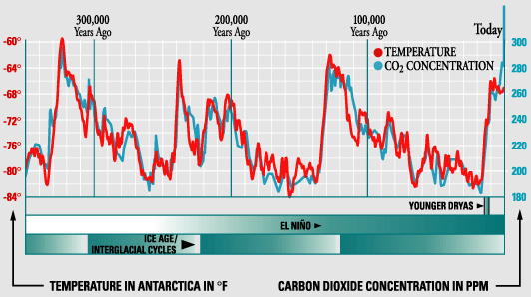
Graph 2.

Slide 4
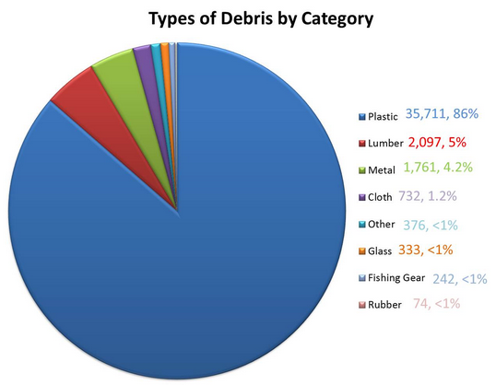
Graph 3.

Slide 5
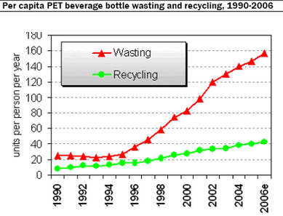
Graph 4.

Slide 6
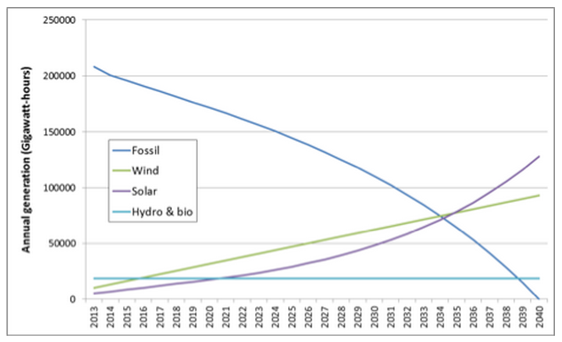
Graph 5.

Slide 7
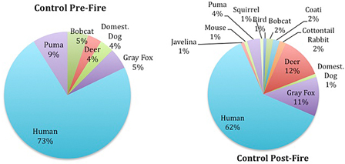
Graph 6.

Slide 8
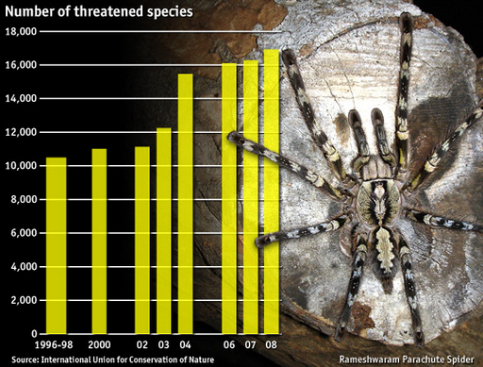
8.7 million total species in the world…
Graph 7.

