Slide 1
Small Molecules and Ions as Second Messengers
The extracellular signal molecule (ligand) that binds to the receptor is a pathway’s “first messenger”
Second messengers are small, non-protein, water-soluble molecules or ions that spread throughout a cell by diffusion
Second messengers participate in pathways initiated by G protein-coupled receptors and receptor tyrosine kinases
Cyclic AMP and calcium ions are common second messengers

Slide 2
Cyclic AMP
Cyclic AMP (cAMP) is one of the most widely used second messengers
Adenylyl cyclase, an enzyme in the plasma membrane, converts ATP to cAMP in response to an extracellular signal
ATP
cAMP
AMP

Slide 3
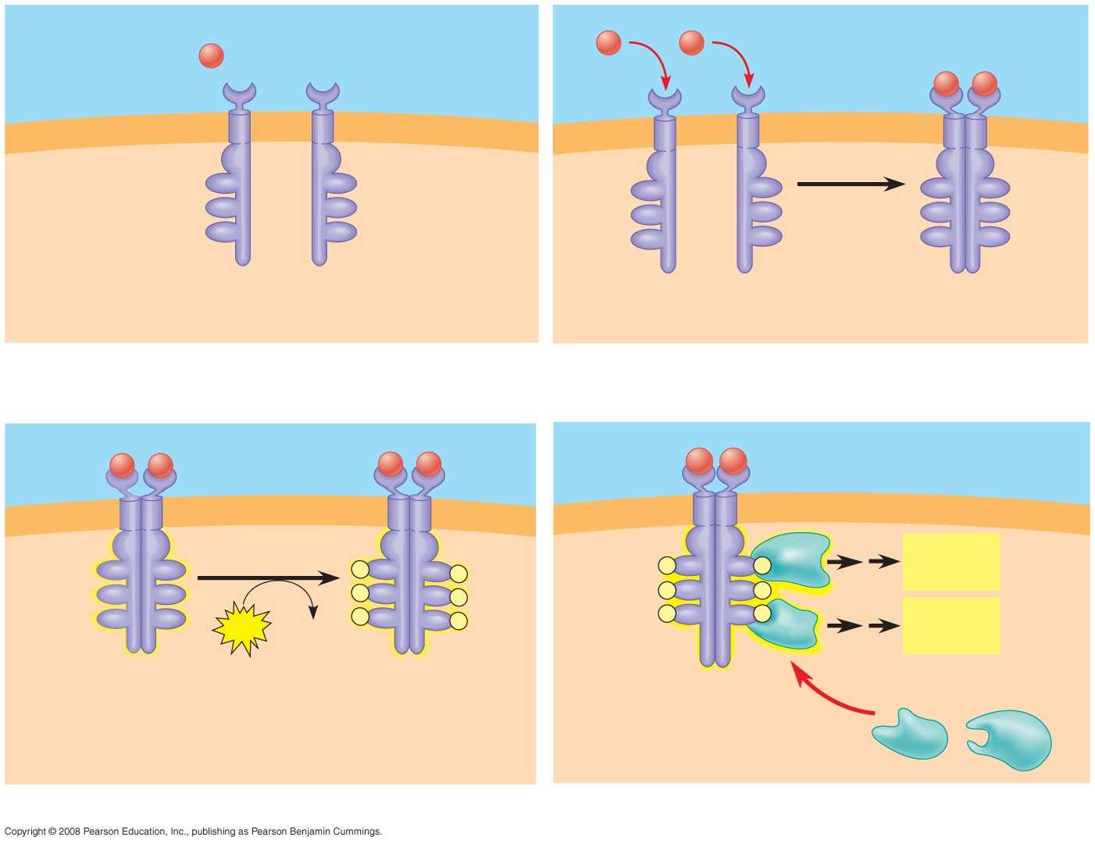
Receptor tyrosine kinases are membrane receptors that attach phosphates to tyrosines
A receptor tyrosine kinase can trigger multiple signal transduction pathways at once
Signaling
molecule (ligand)
Ligand-binding site
Signaling
molecule
α Helix
Tyrosines
Tyr
Tyr
Tyr
Tyr
Tyr
Tyr
Tyr
Tyr
Tyr
Tyr
Tyr
Tyr
Tyr
Tyr
Tyr
Tyr
Tyr
Tyr
Receptor tyrosine
kinase proteins
Dimer
CYTOPLASM
1
2
Activated relay
proteins
Cellular
response 1
Tyr
Tyr
P
Tyr
Tyr
P
P
Tyr
Tyr
P
Tyr
Tyr
P
Tyr
Tyr
P
P
Tyr
Tyr
P
Tyr
Tyr
6
ATP
6 ADP
P
Tyr
Tyr
P
P
Tyr
Tyr
P
Cellular
response 2
Activated tyrosine
kinase regions
Fully activated receptor
tyrosine kinase
Inactive
relay proteins
3
4
Notes:
Figure 11.7 Membrane receptors—receptor tyrosine kinases

Slide 4
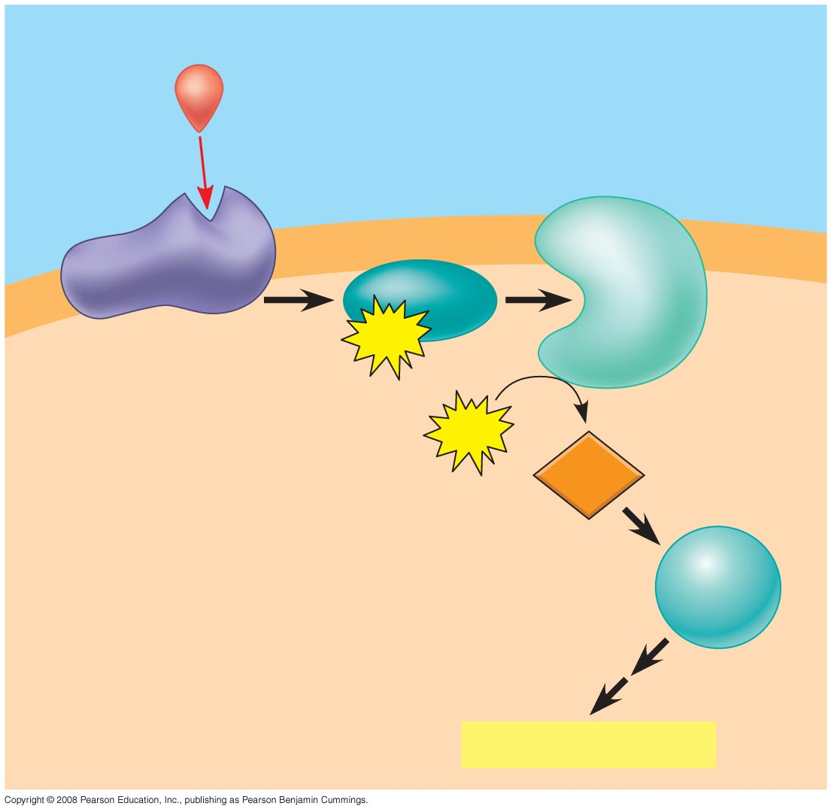
Many signal molecules trigger formation of cAMP
Other components of cAMP pathways are G proteins, G protein-coupled receptors, and protein kinases
cAMP usually activates protein kinase A, which phosphorylates various other proteins
Further regulation of cell metabolism is provided by G-protein systems that inhibit adenylyl cyclase
First messenger
Adenylyl
cyclase
G protein
G protein-coupled
receptor
GTP
ATP
Second
messenger
cAMP
Protein
kinase A
Cellular responses

Slide 5
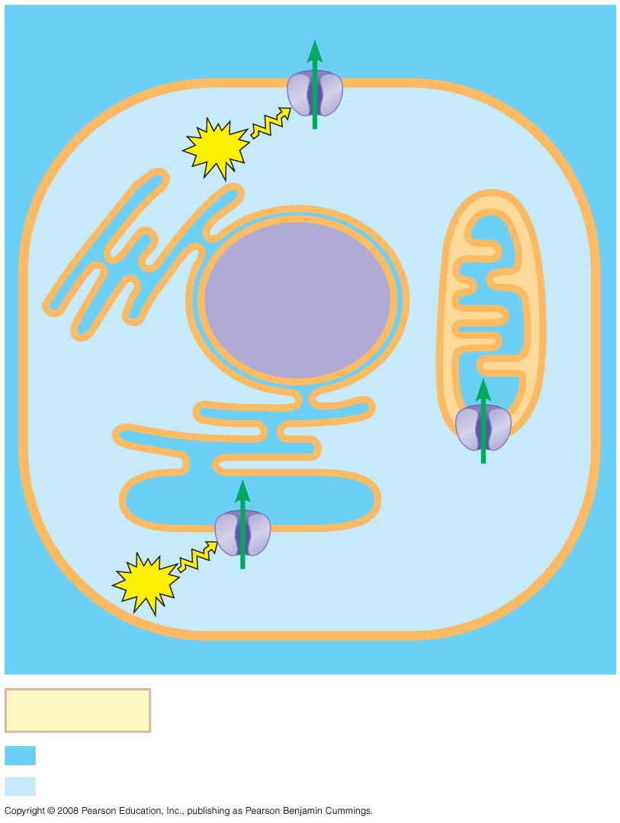
Calcium Ions and Inositol Triphosphate (IP₃)
EXTRACELLULAR
FLUID
Plasma
membrane
Ca²⁺ pump
ATP
Calcium ions (Ca²⁺) act as a second messenger in many pathways
Calcium is an important second messenger because cells can regulate its concentration
Mitochondrion
Nucleus
CYTOSOL
Ca²⁺
pump
Endoplasmic
reticulum (ER)
Ca²⁺
pump
ATP
Key
High [Ca²⁺]
Low [Ca²⁺]

Slide 6
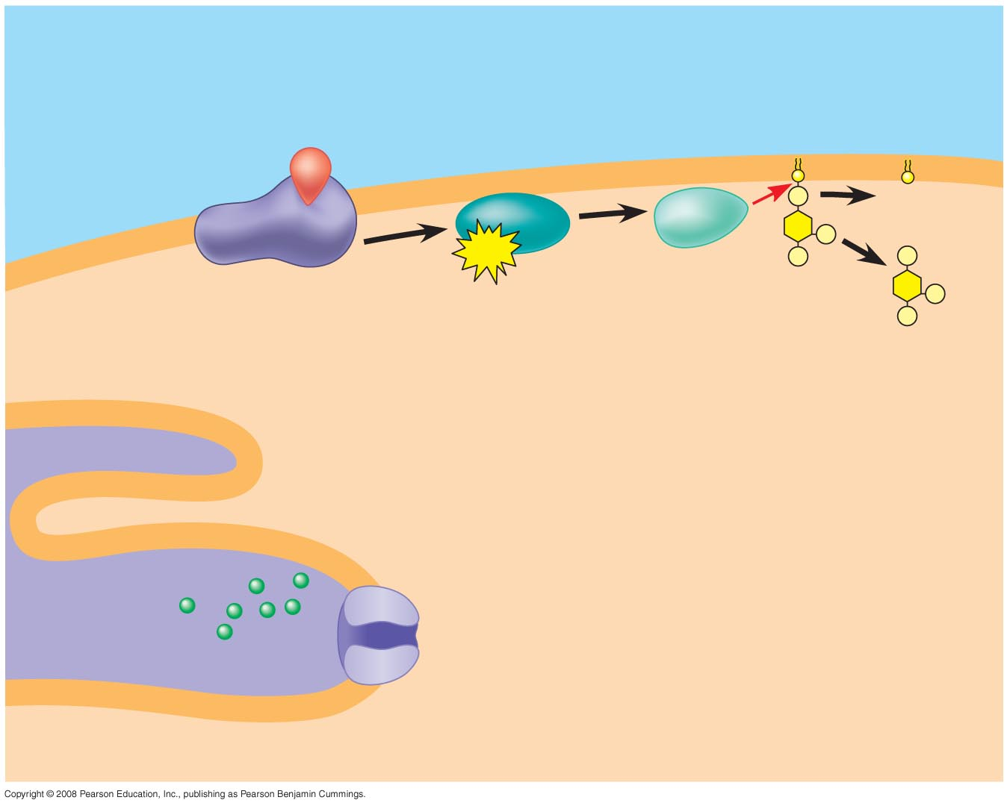
EXTRA-
CELLULAR
FLUID
Signaling molecule
(first messenger)
G protein
DAG
GTP
G protein-coupled
receptor
Phospholipase C
PIP₂
IP₃
(second messenger)
A signal relayed by a signal transduction pathway may trigger an increase in calcium (2nd messenger) in the cytosol
Pathways leading to the release of calcium involve inositol triphosphate (IP₃) and diacylglycerol (DAG) as additional second messengers
IP₃-gated
calcium channel
Endoplasmic
reticulum (ER)
Ca²⁺
CYTOSOL
Notes:
Figure 11.13 Calcium and IP₃ in signaling pathways

Slide 7
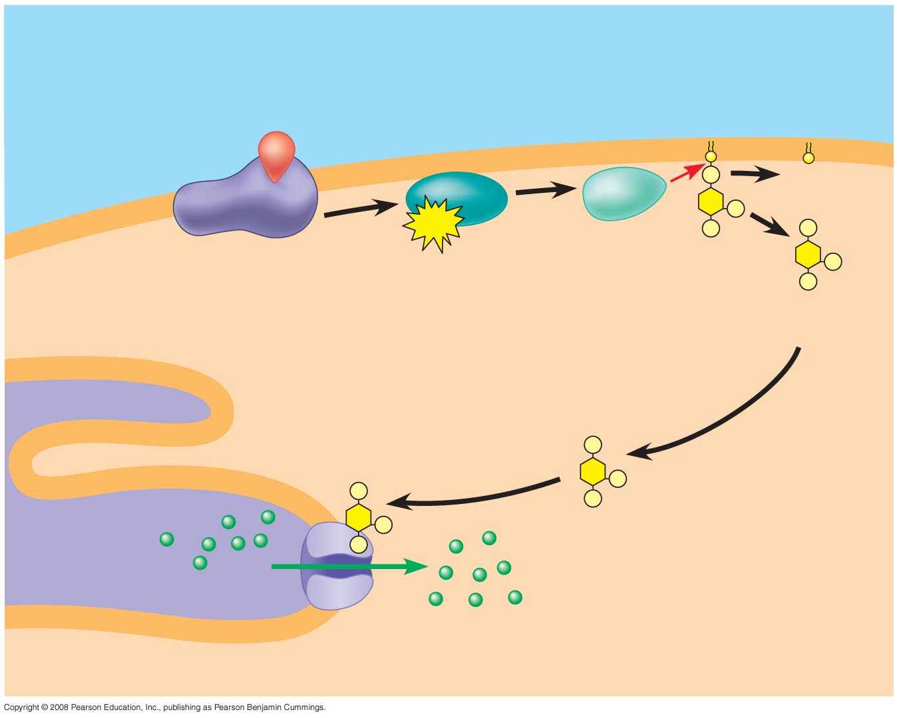
EXTRA-
CELLULAR
FLUID
Signaling molecule
(first messenger)
G protein
DAG
GTP
G protein-coupled
receptor
Phospholipase C
PIP₂
IP₃
(second messenger)
IP₃-gated
calcium channel
Endoplasmic
reticulum (ER)
Ca²⁺
Ca²⁺
(second
messenger)
CYTOSOL
Notes:
Figure 11.13 Calcium and IP₃ in signaling pathways

Slide 8
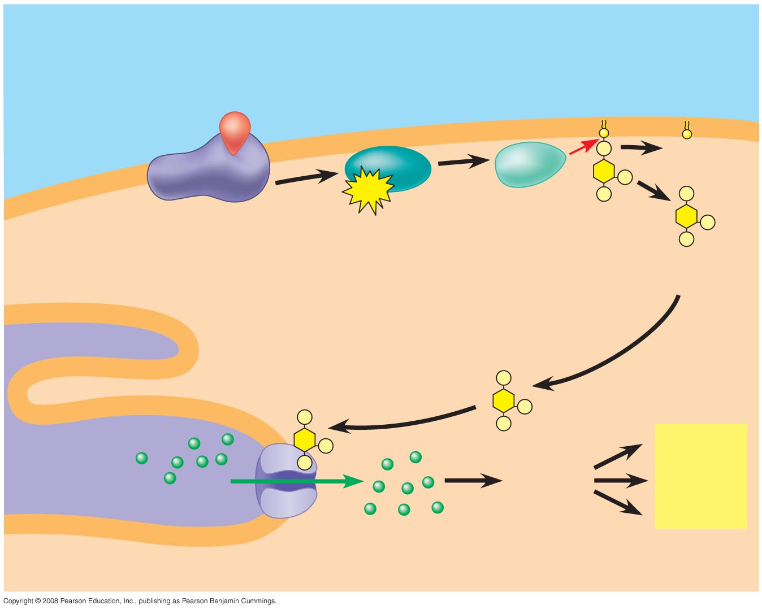
Cell signaling leads to regulation of transcription or cytoplasmic activities
The cell’s response to an extracellular signal is sometimes called the “output response”
EXTRA-
CELLULAR
FLUID
Signaling molecule
(first messenger)
G protein
DAG
GTP
G protein-coupled
receptor
Phospholipase C
PIP₂
IP₃
(second messenger)
IP₃-gated
calcium channel
Endoplasmic
reticulum (ER)
Various
proteins
activated
Cellular
responses
Ca²⁺
Ca²⁺
(second
messenger)
CYTOSOL
Notes:
Figure 11.13 Calcium and IP₃ in signaling pathways

Slide 9
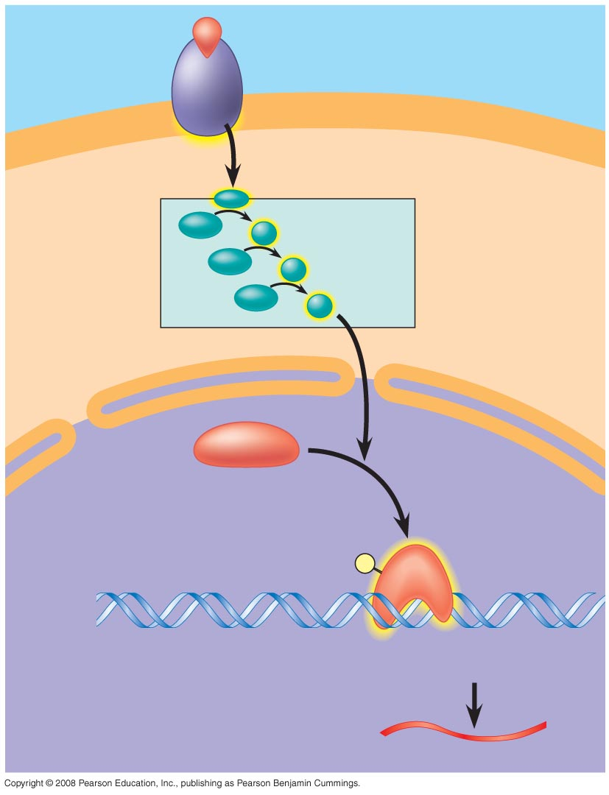
Nuclear and Cytoplasmic Responses
Growth factor
Reception
Receptor
Ultimately, a signal transduction pathway leads to regulation of one or more cellular activities
The response may occur in the cytoplasm or may involve action in the nucleus
Many signaling pathways regulate the synthesis of enzymes or other proteins, usually by turning genes on or off in the nucleus
The final activated molecule may function as a transcription factor
Phosphorylation
cascade
Transduction
CYTOPLASM
Inactive
transcription
factor
Active
transcription
factor
P
Response
DNA
Gene
NUCLEUS
mRNA

Slide 10
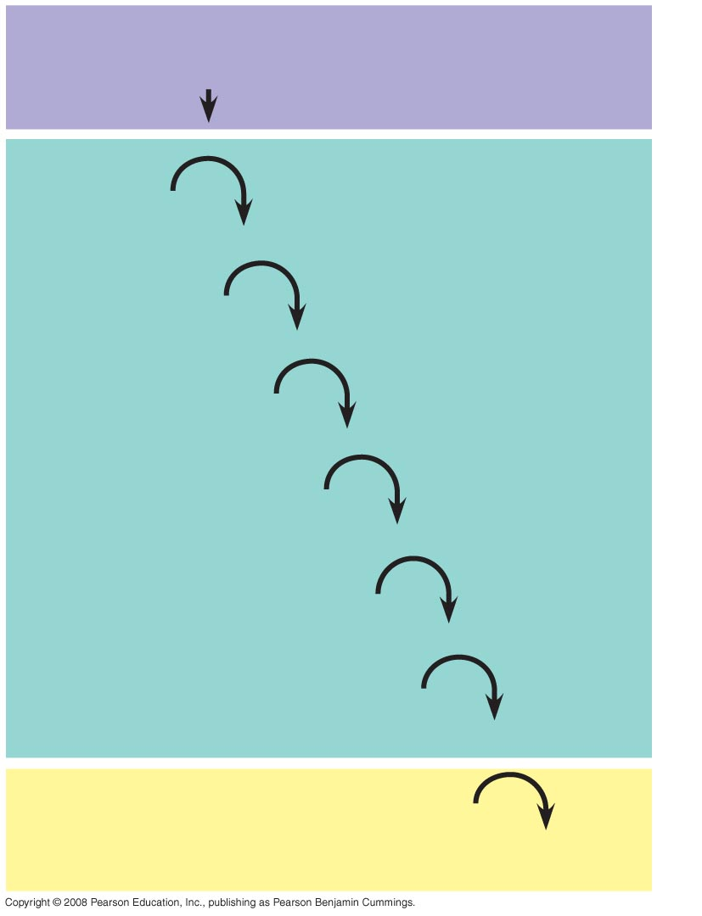
Other pathways regulate the activity of enzymes
Reception
Binding of epinephrine to G protein-coupled receptor (1 molecule)
Transduction
Inactive G protein
Active G protein (10² molecules)
Inactive adenylyl cyclase
Active adenylyl cyclase (10²)
ATP
Cyclic AMP (10⁴)
Inactive protein kinase A
Active protein kinase A (10⁴)
Inactive phosphorylase kinase
Active phosphorylase kinase (10⁵)
Inactive glycogen phosphorylase
Active glycogen phosphorylase (10⁶)
Response
Glycogen
Glucose-1-phosphate
(10⁸ molecules)
Notes:
Figure 11.15 Cytoplasmic response to a signal: the stimulation of glycogen breakdown by epinephrine

Slide 11
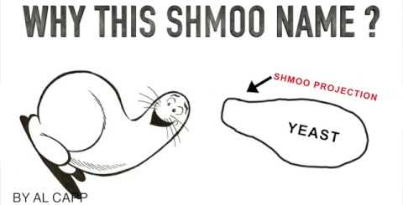
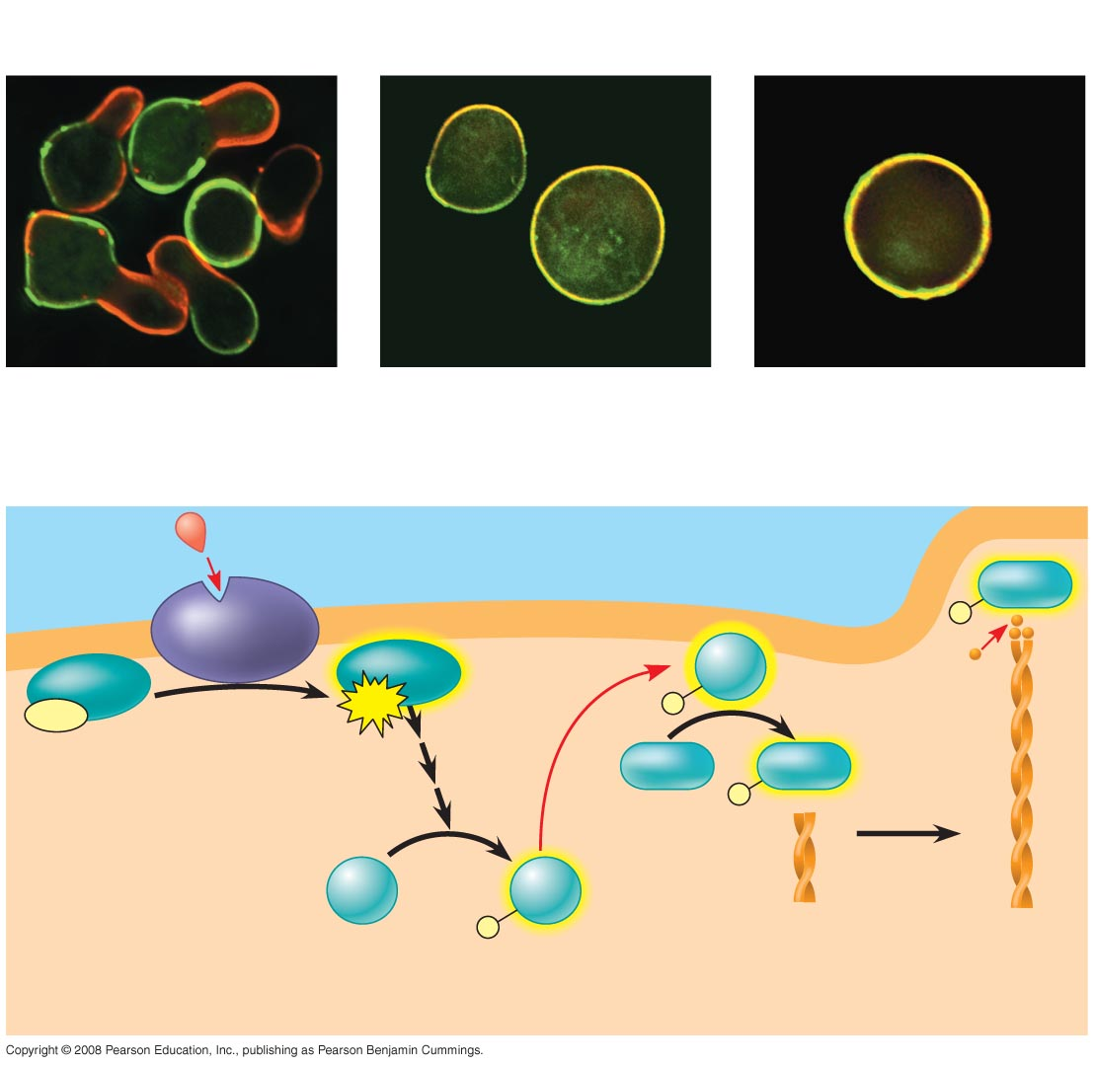
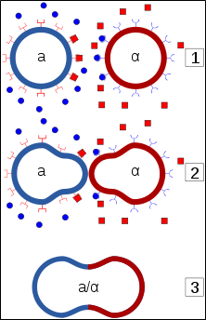
RESULTS
Signaling pathways can also affect the physical characteristics of a cell, for example, cell shape
Wild-type (shmoos)
∆Fus3
∆formin
CONCLUSION
1
Mating
factor
Shmoo projection forming
G protein-coupled
receptor
Formin
P
Fus3
Actin
subunit
GDP
GTP
P
2
Phosphory-
lation
cascade
Formin
Formin
P
4
Fus3
Fus3
Microfilament
P
5
3
Notes:
Figure 11.16 How do signals induce directional cell growth in yeast?

Slide 12
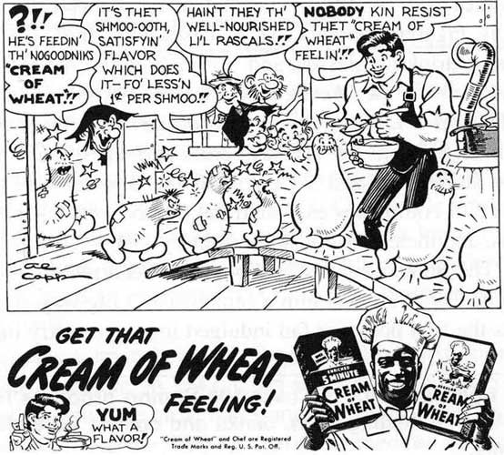
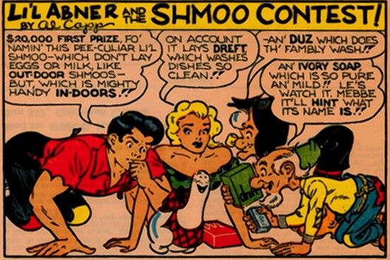

Slide 13
Questions to set your compass…
What evidence is there that S. cerevisiae is communicating?
How do the S. cerevisiae monocultures differ from the mixed culture observations?
What pathway are we investigating that is involved with this process and how does it work?
How do S. cerevisiae cells communicate?

Slide 14
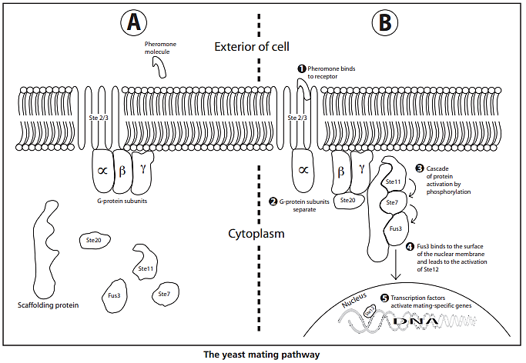

Slide 15
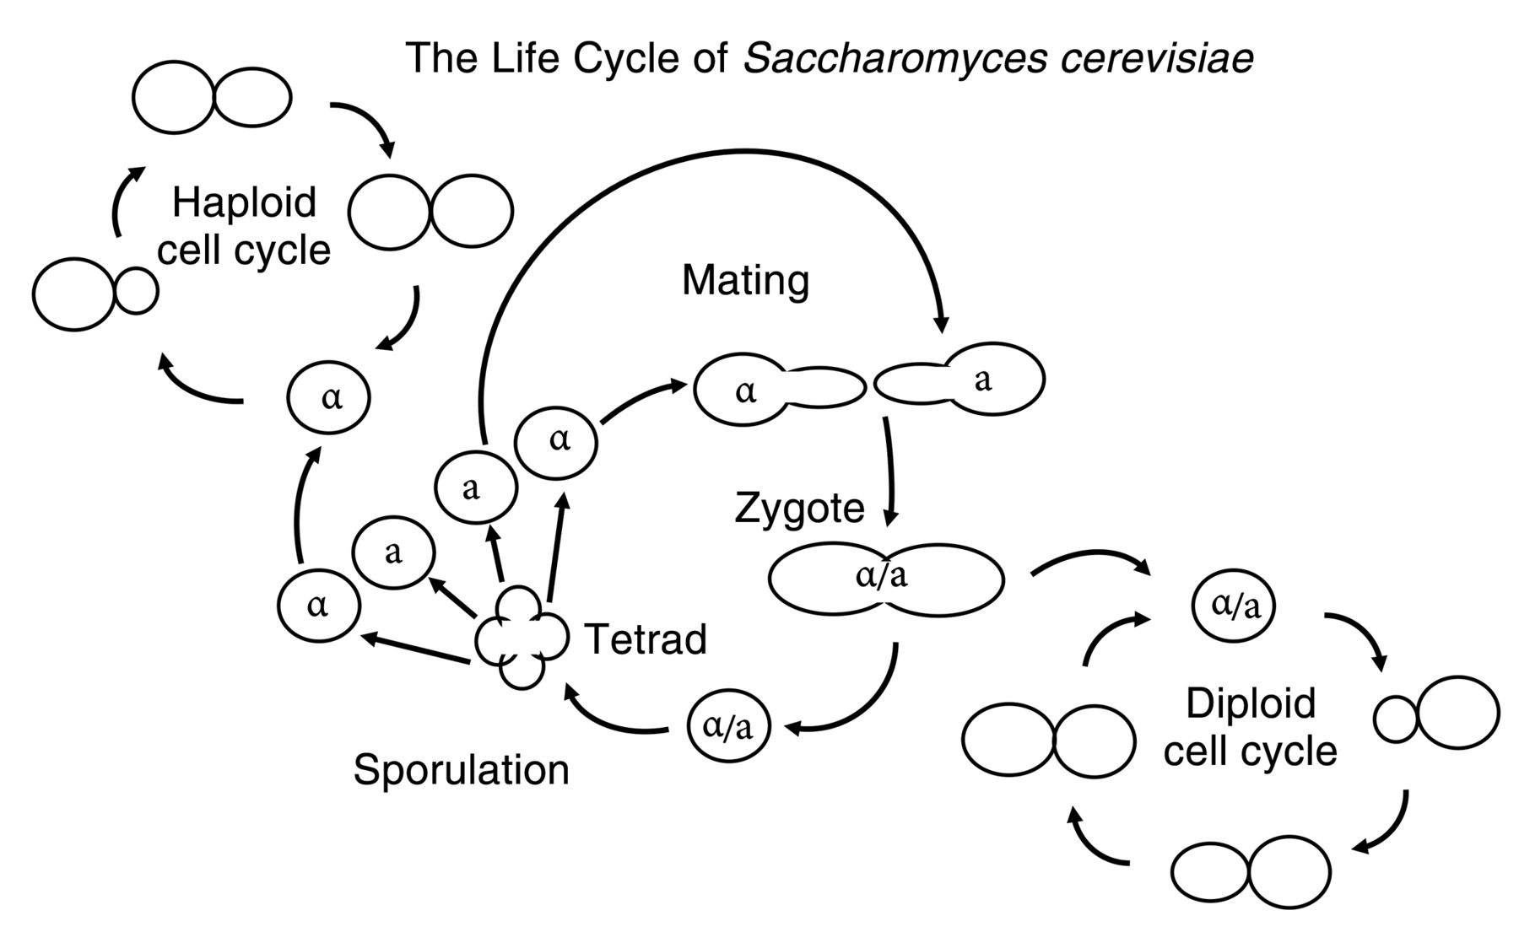

Slide 16
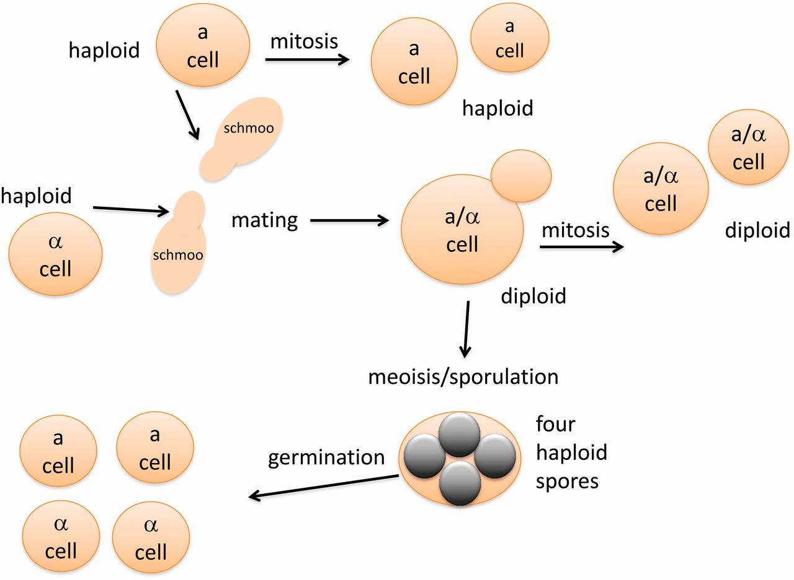

Slide 17
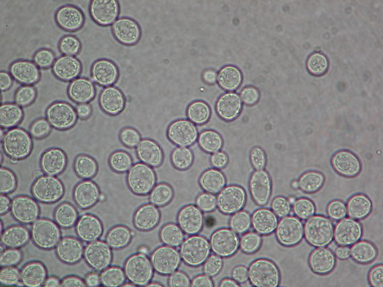
Yeast cell types observed.
1. Single haploid
2. Budding haploid
3. Shmoos
4. Single zygotes
5. Budding zygotes
6. Asci (cluster of 4 haploid spores)

Slide 18
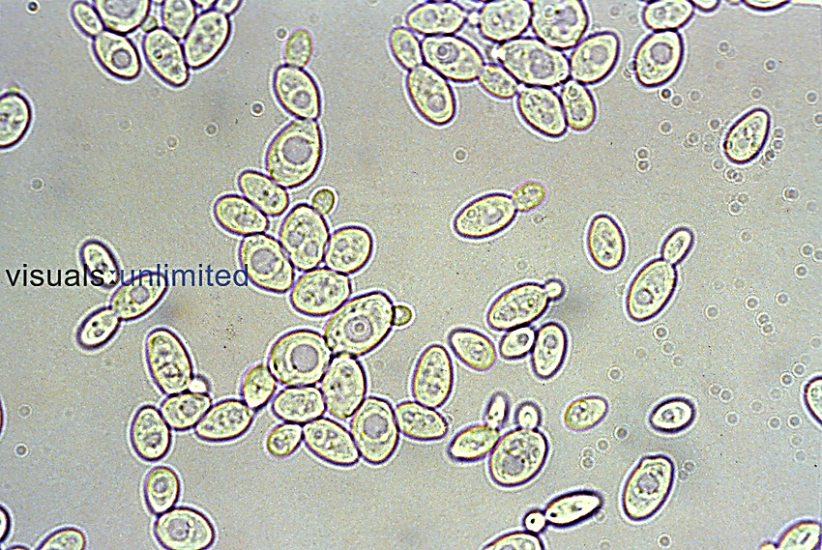

Slide 19
