Slide 1
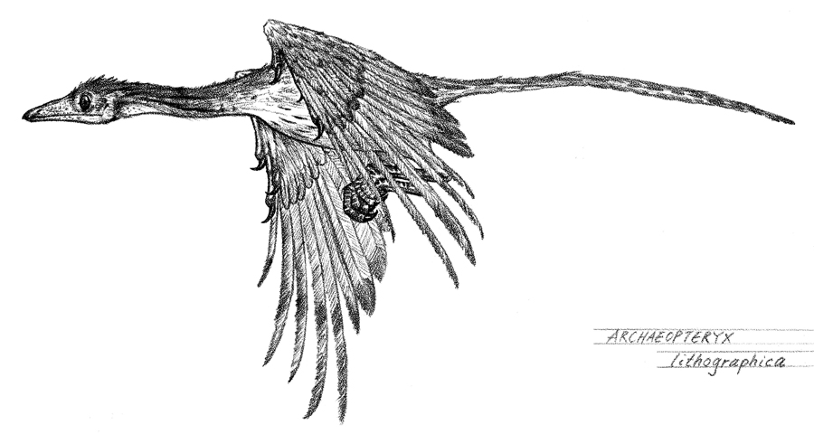
Mr. F’s Biology & Marine Biology

Slide 2
Today’s Agenda
Course syllabus
Policies (HW, lav, electronics, drills)
Laboratory Safety
About you

Slide 3
Course Syllabus
How is the course organized?
What do I do If I’m absent?
What will the course cover?

Slide 4
Policies
Homework
Lavatory
Electronics
Fire drills
Lockdowns

Slide 5
Laboratory Safety
Eye safety Fire blanket
Eyewash Glass wear
Broken glass Spills
Injuries

Slide 8
Emergency Procedures
Allergic reactions
Fire
Lockdown

Slide 9
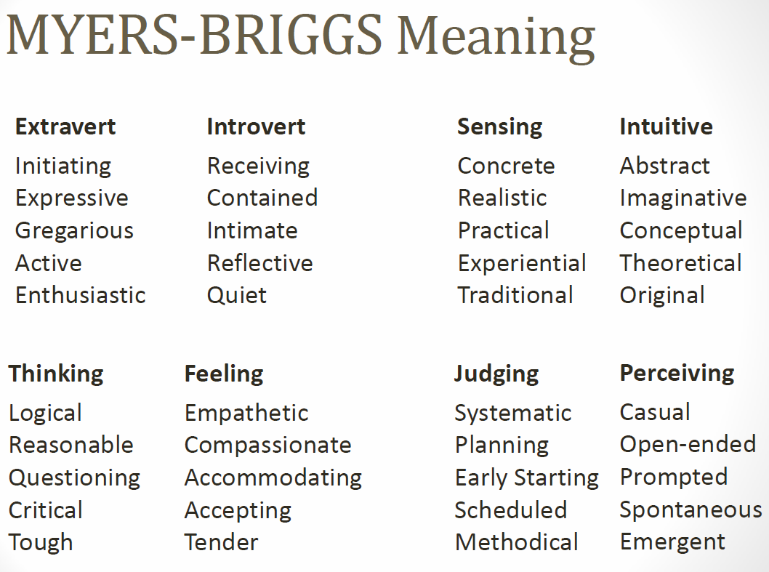

Slide 10
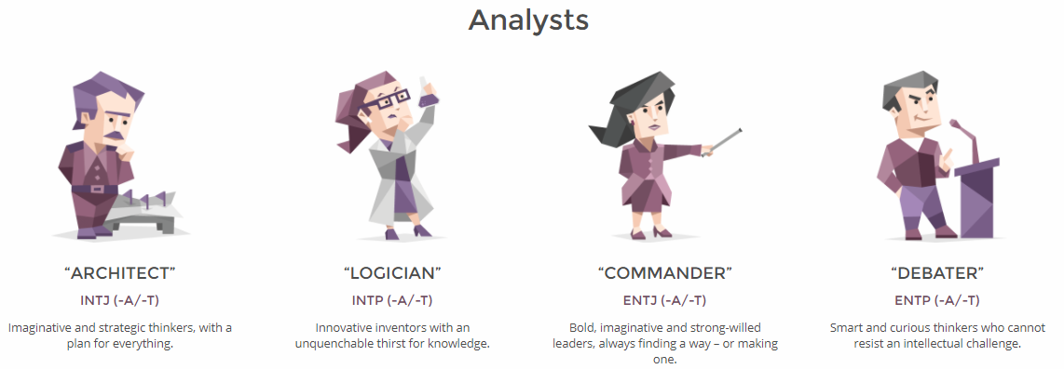
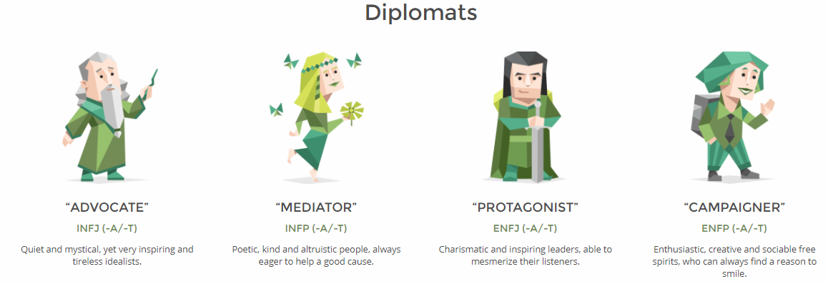

Slide 11
